Slide 1


GTI (POL)
DBMS Project
Prepared by group3

Slide 2




Team Members
.Ma Shoon Lae Wai
Ma Yoon Darli Win Maung.
.Ma Shar Thet Han
Ma Khain Htike Htar Oo.
.Ma Aye Nyein Phyo
Mg Htet Yan Aung.

Slide 3
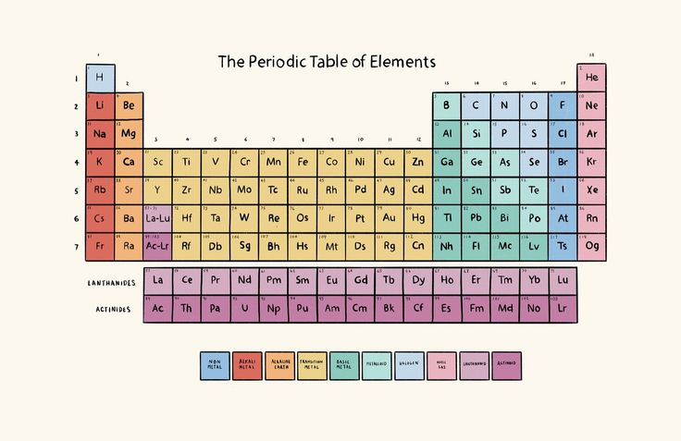
Periodic Table
The Periodic Table is a chart that organizes all known chemical elements based on their atomic number, electron configuration, and recurring chemical properties.
It helps scientists understand how elements behave and relate to one another. The elements are arranged in rows called periods

Slide 4
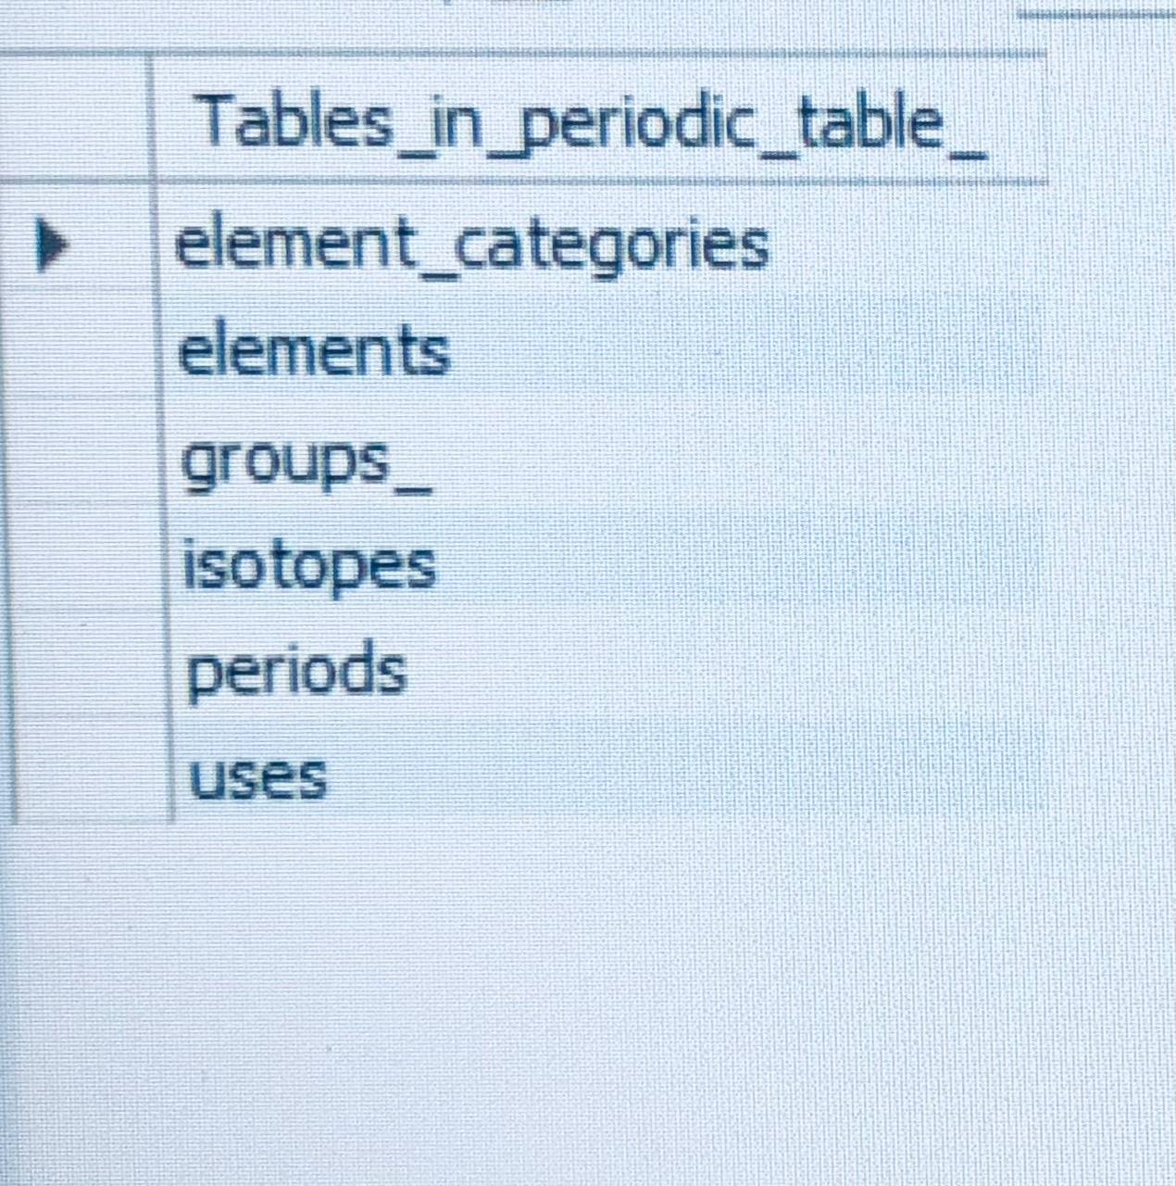
Tables
Create tables in MY SQL
element_ categories
Elements
Groups_
Isotopes
Periods
uses

Slide 5
Element table structure
Columns
Data Type
Constrains/Description
Element_id
-name
-symbol
-atomic_number
-atomic_mass
-period
-group_id
-block
-electron_configuration
-state_at_stp
-melting_point_k
-boiling_point_k
-density_g_cm3
-electronegativity
-ionization_energy_kj_mol
-electron_affinity_kj_mol
-description
-category_id
INT
VARCHAR(50)
VARCHAR(3)
INT
DECIMAL(10, 5)
INT
INT
VARCHAR(1)
VARCHAR(255)
VARCHAR(20)
DECIMAL(8, 2)
DECIMAL(8, 2)
DECIMAL(8, 4)
DECIMAL(4, 2)
DECIMAL(8, 2)
DECIMAL(8, 2)
TEXT
INT
AUTO_INCREMENT PRIMARY KEY
UNIQUE NOT NULL
UNIQUE NOT NULL
UNIQUE NOT NULL
NOT NULL
NOT NULL
(none)
(none)
(none)
(none)
(none)
(none)
(none)
(none)
(none)
(none)
(none)
FOREIGN KEY (category_id) REFERENCES element_categories(category_id)

Slide 6
Insert data in element table
INSERT INTO elements (
name, symbol, atomic_number, atomic_mass, period, group_id, block,
electron_configuration, state_at_stp, melting_point_k, boiling_point_k,
density_g_cm3, electronegativity, ionization_energy_kj_mol,
electron_affinity_kj_mol, description, category_id
) VALUES
(
'Hydrogen', 'H', 1, 1.00784, 1, 1, 's',
'1s1', 'gas', 13.99, 20.27,
0.00008988, 2.20, 1312.00,
72.8, 'Lightest element, essential in water and organic compounds.', 1
);

Slide 7
Insert data in all tables
Isotopes table
Element caregories table
INSERT INTO Isotopes (element_id, mass_number, symbol, natural_abundance, half_life_days, decay_mode, is_radioactive) VALUES
INSERT INTO element_categories (category_name, category_description) VALUES('Alkali Metal', 'Very reactive metals that readily lose their outermost electron.'),('Alkaline Earth Metal', 'Reactive metals, commonly found in the Earth''s crust.'),
Group table
INSERT INTO Groups_ (group_id, group_name, description) VALUES(1, 'Alkali Metals', 'Highly reactive metals with one valence electron. Form +1 ions.'),
Period table
INSERT INTO Periods (period_id, period_name, description) VALUES(1, 'Period 1', 'Contains hydrogen and helium. Only 2 elements.'),(2, 'Period 2', 'Contains elements from lithium to neon. 8 elements.'),
Uses table
INSERT INTO Uses (element_id, application, details) VALUES-- Hydrogen (element_id = 1)(1, 'Fuel', 'Used as rocket fuel and in fuel cells.'),

Slide 8
Sample queries
-- Noble gas
SELECT e.name, e.symbol, ec.category_nameFROM elements eJOIN element_categories ec ON e.category_id = ec.category_idWHERE ec.category_name = 'Noble Gas';
>SELECT * FROM elements ;
>select * from element_categories;
>select * from periods;
>select * from isotopes;
>select * from uses;

Slide 9
Samples
-- Atomic
NumberSELECT name, symbol, atomic_number, state_at_stpFROM elementsWHERE atomic_number <= 50 AND state_at_stp = 'Solid'ORDER BY atomic_number;

Slide 10
-- join opreationselect
-- ordering&limiting
.name,elements.symbol,element_categories.category_namefrom elements join element_categories on elements.group_id= element_categories.category_id;
select name,symbol, atomic_number from elements order by atomic_number asc;

Slide 11
Conclusion

Slide 12
Thank you
/From group 3

Slide 13
Question
&
Answer

